Slide 1

Cryptocurrency Converter
Zachary Merrill
G00958422
IT 106 - 014

Slide 2
Project Description
This project is aimed at creating a cryptocurrency calculator that allows the user to convert, calculate, and analyze the pricing of the world of universal digital currencies. This topic is something that has interested me since I mine cryptocurrency on the side with my brothers. This application is targeted at anyone interested in or using cryptocurrencies. The application will include the following functionalities.
Conversions for the most known cryptocurrencies
Calculating how much each cryptocurrency is worth in USD
The ability to change/update the value of cryptocurrencies to their current value
The ability to add a new upcoming cryptocurrency to a pool
The ability to remove cryptocurrencies from the pool
The ability to view the names, prices, conversions, supply, and ranks of all added to the pool

Slide 3
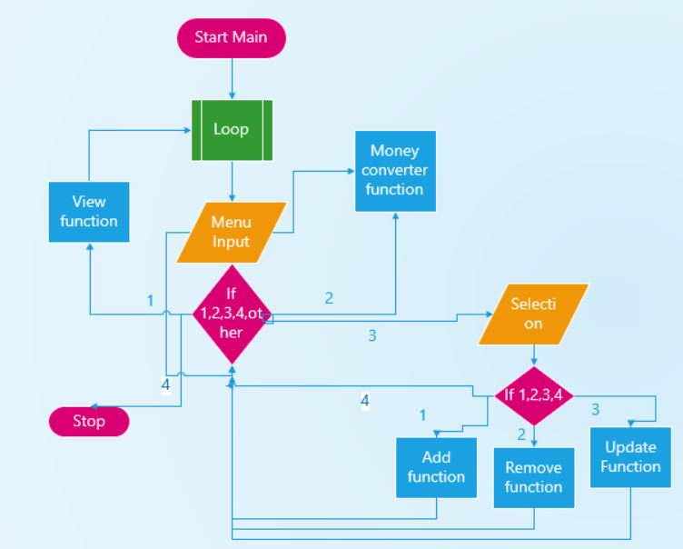
Program Structure
A sample flowchart

Slide 4
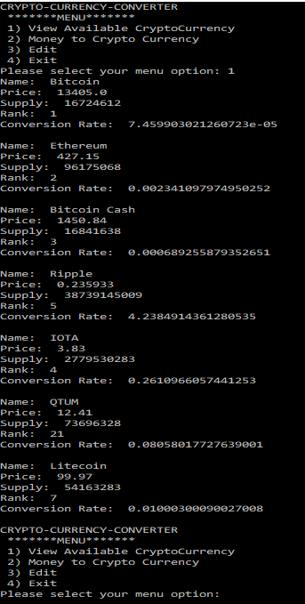
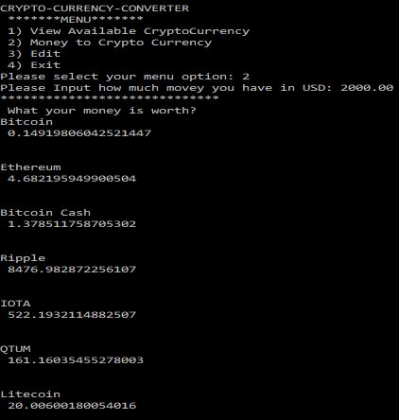
Input/Output
The user will be presented a menu to choose between the functionalities. The user would then input the related variables and the application would print the desired output.

Slide 5
Future Work
Would like to add profiles for individual users.
Add graph functionality.
Updating rates

Slide 6
References
https://coinranking.com/

